Slide 1
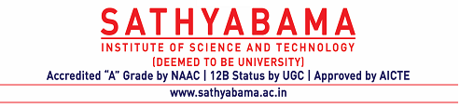
Subject Code: SCS1301 Subject Name: Operating System Faculty Name: Dr. A. Jesudoss

Slide 2
Agenda
Syllabus
Books Recommended
Roadmap to Unit 1
Introduction
Operating System Goals
Operating System Structures
System Components
Process Management
Main Memory Management
File Management
I/O System Management
Secondary Management
Networking
Protection System
Command-Interpreter System

Slide 3
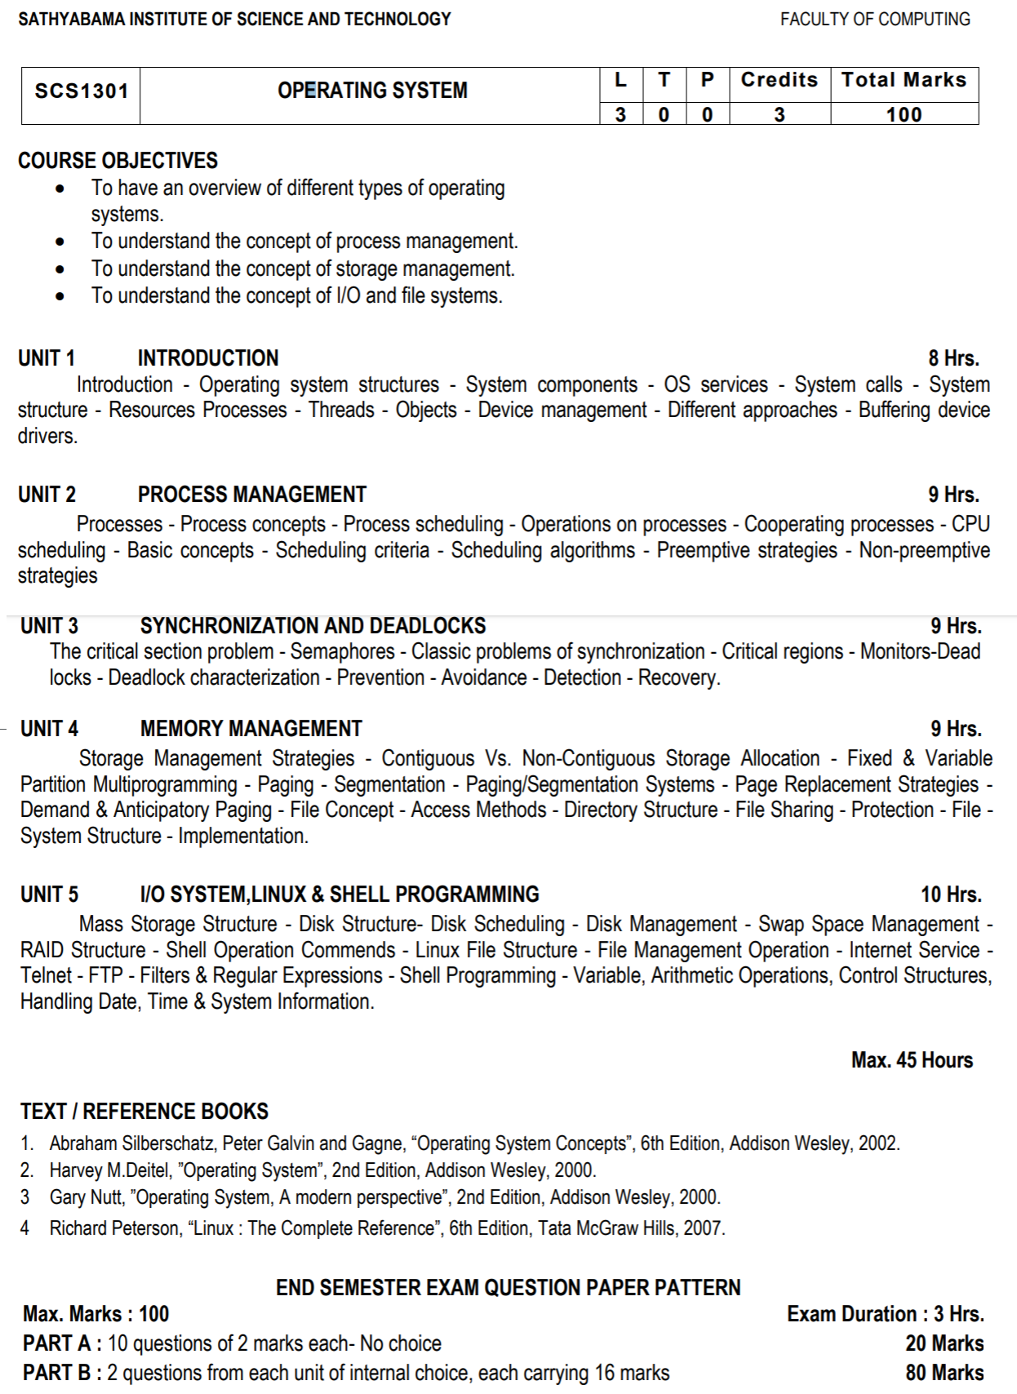

Slide 4
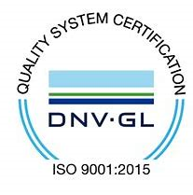
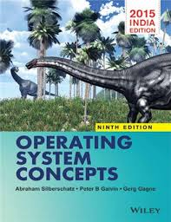
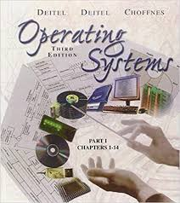
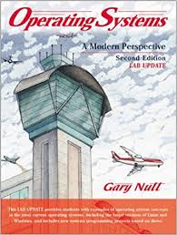
Recommended Books:

Slide 5
Roadmap to UNIT I
Introduction
Operating system structures
System Components
OS Services
System Calls
System Structure
Resources
Processes
Threads
Objects
Device Management
Different approaches
Buffering device drivers.

Slide 6
1. INTRODUCTION
A computer system has many resources (hardware and software), which may be require to complete a task.
Operating System is a system software that acts as an intermediary between a user and Computer Hardware to enable convenient usage of the system and efficient utilization of resources.
The commonly required resources are input/output devices, memory, file storage space, CPU etc.
Also an operating system is a program designed to run other programs on a computer.

Slide 7
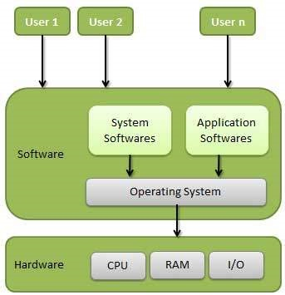
Fig. 1. Abstract View of the Components of a Computer System.

Slide 8
OS is considered as the backbone of a computer, managing both software and hardware resources.
They are responsible for everything from the control and allocation of memory to recognizing input from external devices and transmitting output to computer displays.
They also manage files on computer hard drives and control peripherals, like printers and scanners.

Slide 9
Operating systems monitor different programs and users, making sure everything runs smoothly, without interference, despite the fact that numerous devices and programs are used simultaneously.
An operating system also has a vital role to play in security. Its job includes preventing unauthorized users from accessing the computer system.

Slide 10
Goals of the Operating System
Execute user programs
Make solving user problems easier.
Make the computer system convenient to use.
Use the computer hardware in an efficient manner.

Slide 11
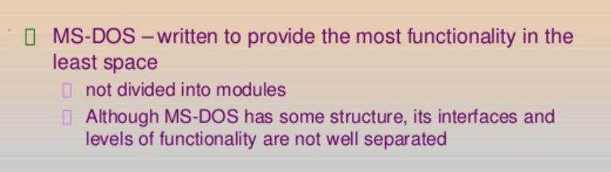
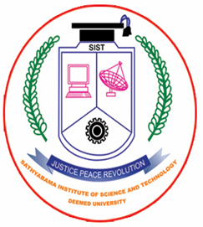
2. OPERATING SYSTEM STRUCTURES
A SIMPLE STRUCTURE: There are many operating systems that have a rather simple structure.
These started as small systems and rapidly expanded much further than their scope. A common example of this is MS-DOS.
MS – DOS SYSTEM STRUCTURE

Slide 12
MS – DOS Structure
Application Programming
Resident System Programming
MS-DOS Drivers
ROM - BIOS Device Drivers

Slide 13
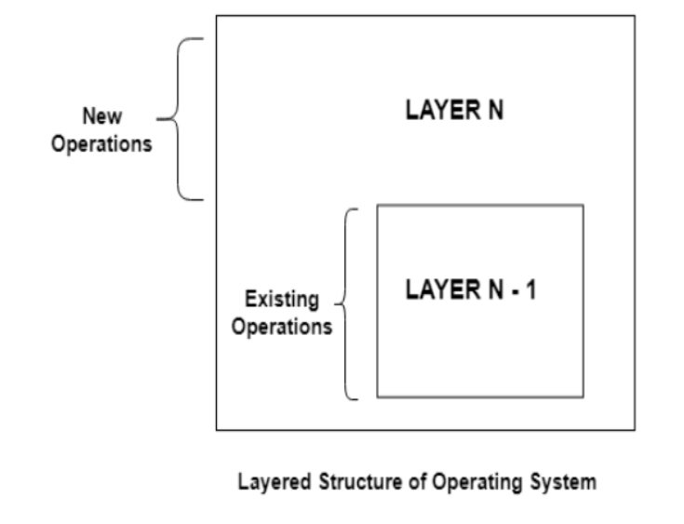
LAYERED STRUCTURE
One way to achieve modularity in the operating system is the layered approach. In this, the bottom layer is the hardware and the topmost layer is the user interface.

Slide 14
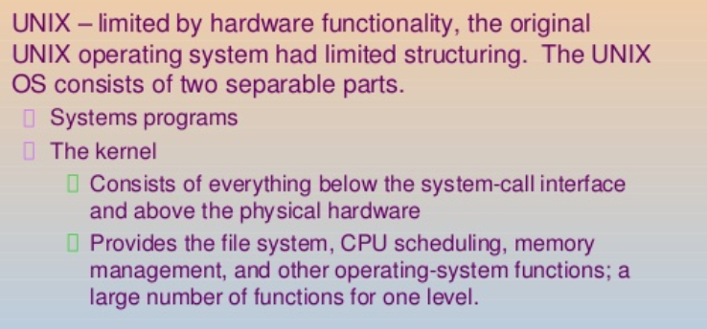
UNIX STRUCTURE

Slide 15
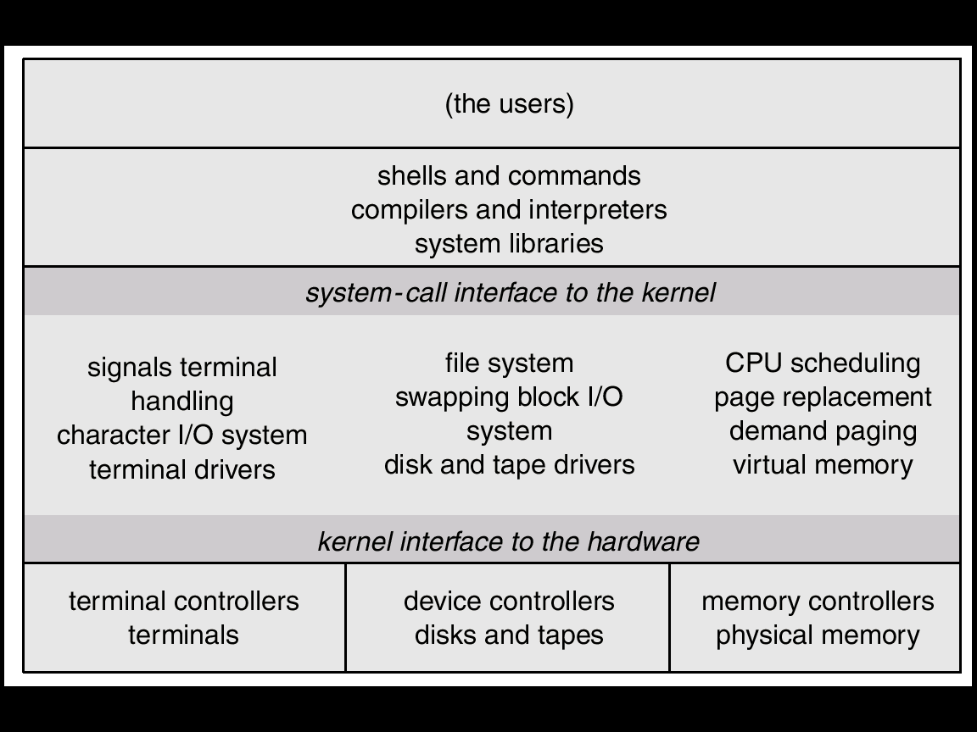
UNIX

Slide 16
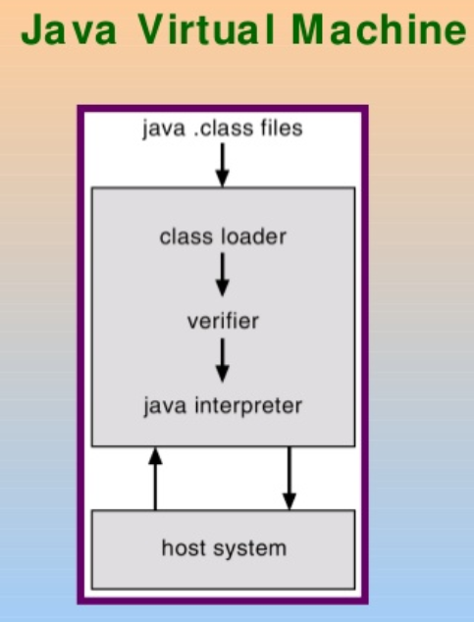
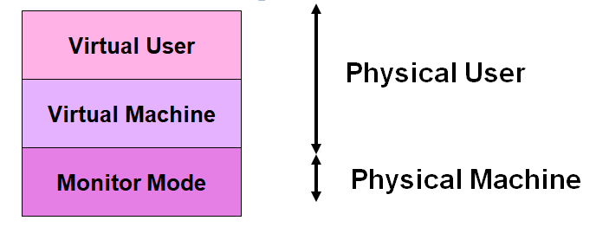
VIRTUAL MACHINE
In a Virtual Machine - each process "seems" to execute on its own processor with its own memory, devices, etc.
The resources of the physical machine are shared. Virtual devices are sliced out of the physical ones. Virtual disks are subsets of physical ones.

Slide 17
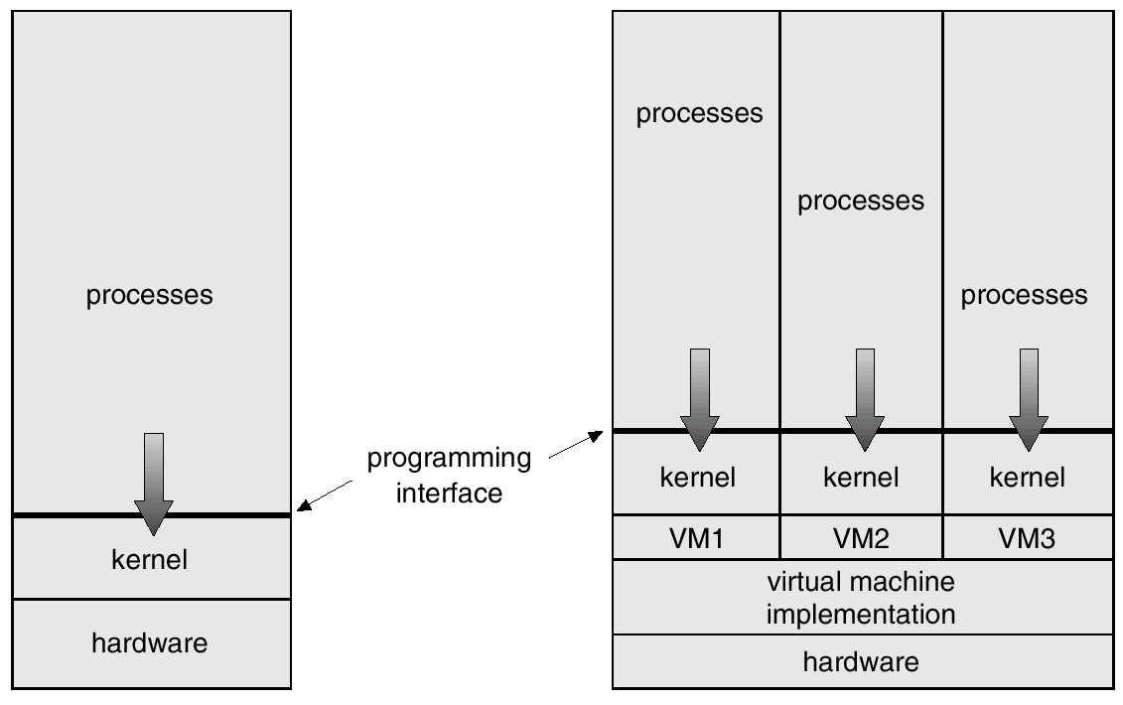
VIRTUAL MACHINE

Slide 18
3. SYSTEM COMPONENTS
We can create a system as large and complex as an operating system by partitioning it into smaller pieces.
Each piece should be a well-delineated (represented accurately or precisely) portion of the system with carefully defined inputs, outputs and functions.
Even though, not all systems have the same structure. However, many modern operating systems share the same goal of supporting the following types of system components:

Slide 19
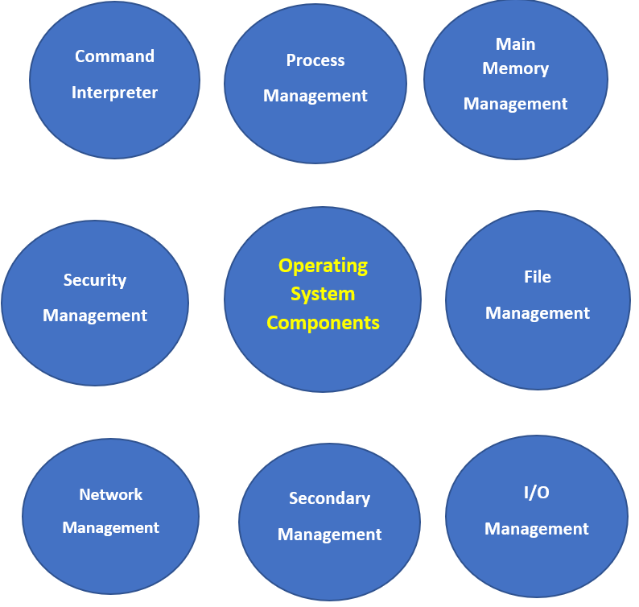
System Components

Slide 20
Process Management
Main Memory Management
File Management
I/O System Management
Secondary Management
Network Management
Protection System – Security Management
Command-Interpreter System

Slide 21
1) Process Management
The operating system manages many kinds of activities ranging from user programs to system programs like printer spooler, name servers, file server etc.
Each of these activities is encapsulated in a process. A program by itself is not a process but a program in execution. For example
− A batch job is a process
− A time-shared user program is a process
− A system task (e.g. spooling output to printer) is a process.
There can be many processes running the same program. A program does nothing unless its instructions are executed by a CPU.
The execution of a process must be sequential

Slide 22
The five major activities of an operating system in regard to process management are:
Creation and deletion of user and system processes.
Suspension and resumption (Block/Unblock) of processes.
Providing mechanism for Process Synchronization.
Providing mechanism for Process Communication.
Providing mechanism for Process Deadlock handling.

Slide 23
2) Main Memory Management
Main memory is central to the operation of a modern computer system.
Primary-Memory or Main-Memory is a large array of words or bytes ranging in size from hundreds of thousands to billion.
Each word or byte has its own address.
Main-memory provides storage that can be accessed directly by the CPU. Hence, it provides the fastest storage
The main memory is only large storage device that the CPU is able to address and access directly for a program to be executed, that must in the main memory.
To improve both the utilisation of the CPU and the speed of the computer’s response to its users, we must keep several programs in memory.

Slide 24
The major activities of an operating system in regard to memory-management are:
Monitoring which part of memory are currently being used and by whom.
Deciding which process are loaded into memory when memory space becomes available.
Allocating and deallocating memory space as needed

Slide 25
3) File Management
File management is one of the most visible components of an OS.
Computers can store information on several different types of physical media (e.g. magnetic tap, magnetic disk, CD etc).
Each of these media has its own properties like speed, capacity, data transfer rate and access methods.
For convenient use of the computer system, the OS provides a uniform logical view of information storage.
A file is a logical storage unit, which abstracts away the physical properties of its storage device.
A file is a collection of related information defined by its creator. Commonly, files represent programs (both source and object forms) and data.

Slide 26
The operating system is responsible for the following activities in connection with file management:
o Creation and deletion of files.
o Creation and deletion of directories.
o Support of primitives for manipulating files and directions.
o Mapping of files onto secondary storage.
o Backing up of files on stable (non volatile) storage media.

Slide 27
4) I/O System Management
OS hides the peculiarities of specific hardware devices from the user.
I/O subsystem consists of:
o A memory management component that includes buffering, caching and spooling.
o A general device-driver interface
o Drivers for specific hardware devices.
Only the device driver knows the peculiarities of the specific device to which it is assigned.

Slide 28
5) Secondary-Storage Management
The main purpose of a computer system is to execute programs.
These programs, with the data they access ,must be in main memory, or primary storage.
Systems have several levels of storage, including primary storage, secondary storage and cache storage.
Since main memory (primary storage) is volatile and too small to accommodate all data and programs permanently, the computer system must provide secondary storage to back up main memory.
Most modern computer systems use disks as the principle on-line storage medium, for both programs and data.

Slide 29
Secondary-Storage Management - contd
The operating system is responsible for the following activities in connection with disk management:
o Free-space management (paging/swapping)
o Storage allocation (what data goes where on the disk)
o Disk scheduling (Scheduling the requests for memory access).

Slide 30
7) Network Management
A distributed systems is a collection of processors that do not share memory, peripheral devices, or a clock.
Instead, each processor has its own local memory and clock, and the processors communicate with one another through various communication lines such as network or high-speed buses.
The processors in a distributed system vary in size and function. They may include small processors, workstations, minicomputers and large, general-purpose computer systems.
The processors in the system are connected through a communication-network, which are configured in a number of different ways i.e.., Communication takes place using a protocol.

Slide 31
The network may be fully or partially connected.
• The communication-network design must consider routing and connection strategies, and the problems of contention and security.
• A distributed system provides user access to various system resources.
• Access to a shared resource allows:
o Computation Speed-up
o Increased functionality
o Increased data availability
o Enhanced reliability

Slide 32
8) Protection System – Security Management
• If a computer system has multiple users and allows the concurrent execution of multiple processes, then the various processes must be protected from one another's activities.
• Protection refers to mechanism for controlling the access of programs, files, memory segments, processes(CPU) only by the users who have gained proper authorization from the OS.
• The protection mechanism must:
o Distinguish between authorized and unauthorized usage.
o Specify the controls to be imposed.
o Provide a means of enforcement.

Slide 33
Command Interpreter System
• A command interpreter is one of the important system programs for an OS.
It is an interface of the operating system with the user.
The user gives commands, which are executed by Operating
system (usually by turning them into system calls).
• The main function of a command interpreter is to get and execute the next user specified command.

